Slide 1
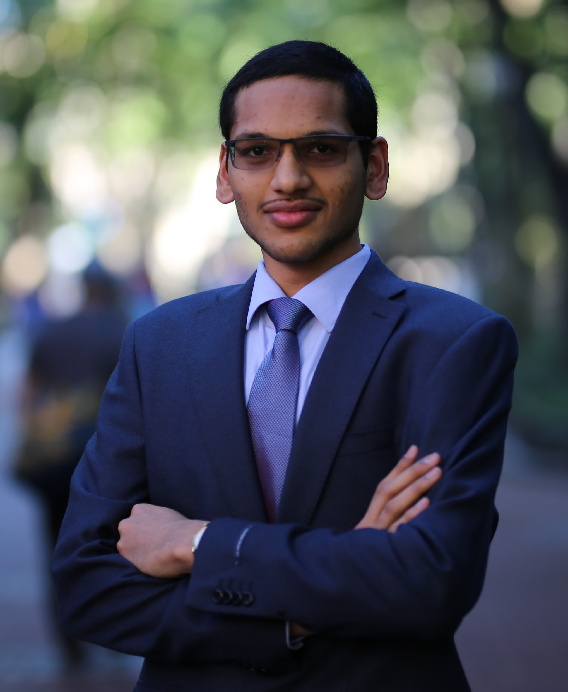
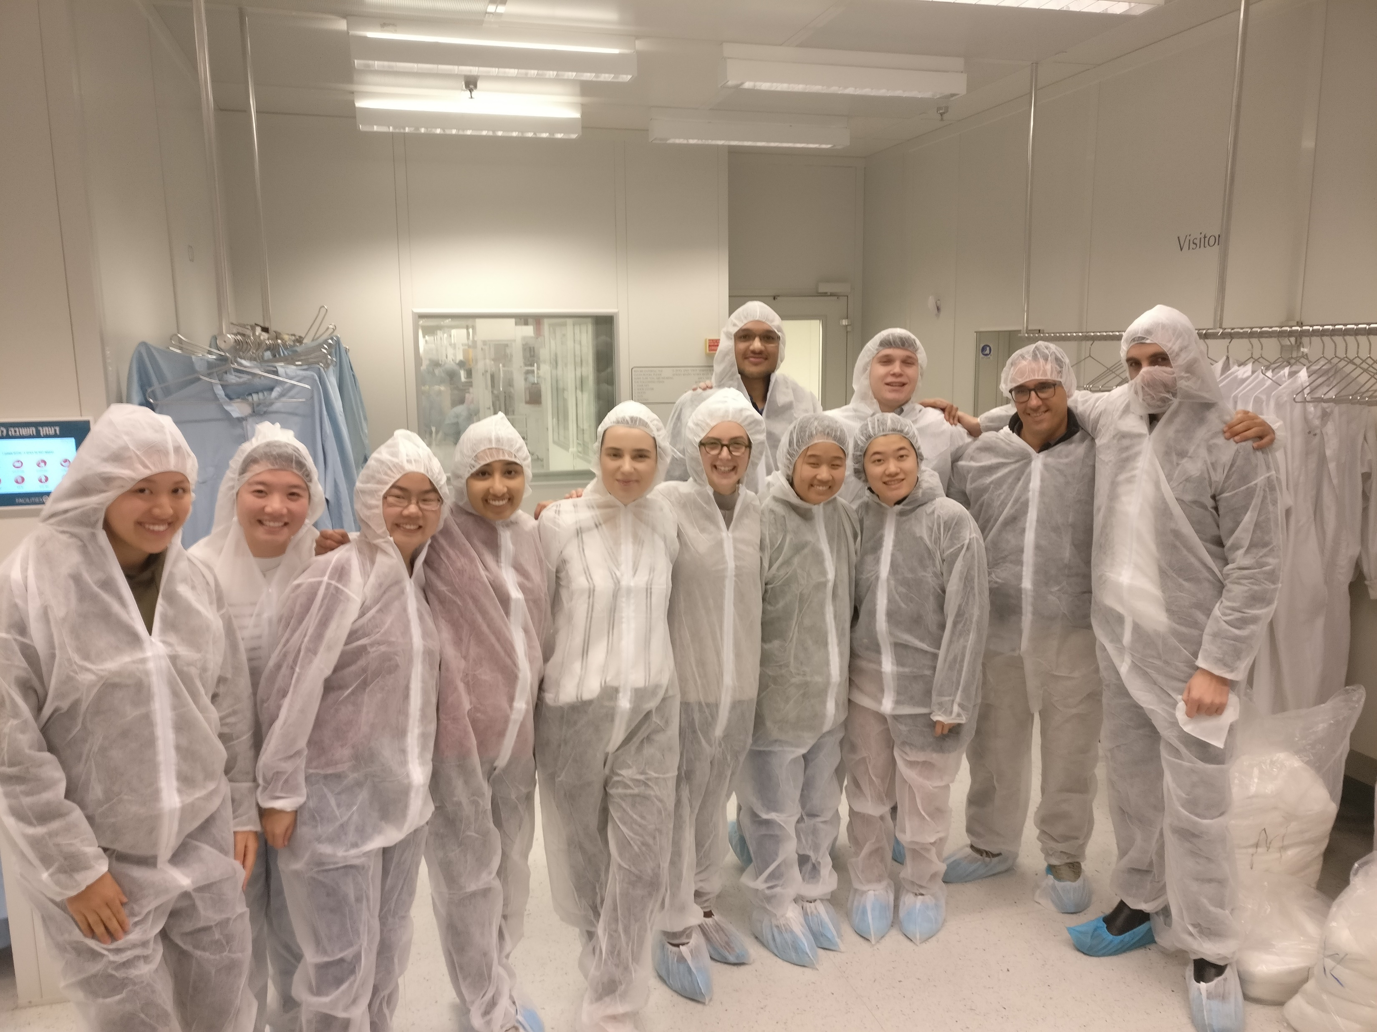
Your Story
Why are you in this Class?
I am a senior studying Operations, Finance and Computer Science in the M&T program. I am also concurrently pursuing a MEng in Robotics through the submat program, graduating in May 2022.
I am interested in understanding operations strategies adopted by firms in the context of the current dynamics of global competition, as well as understanding the role of automation technology in supply chain strategies.
Sheil Sarda
FUN FACT #1
FUN FACT #2
Visited Innoviz, Applied Materials,
SodaStream, Stratasys, etc. in Israel last year through Prof. Cohen’s operations strategy course
Visited Shanghai and Beijing
for 2 weeks in Summer 2018 for the Tencent project with Dr. Allon and attended 2 live eSports games

Slide 2
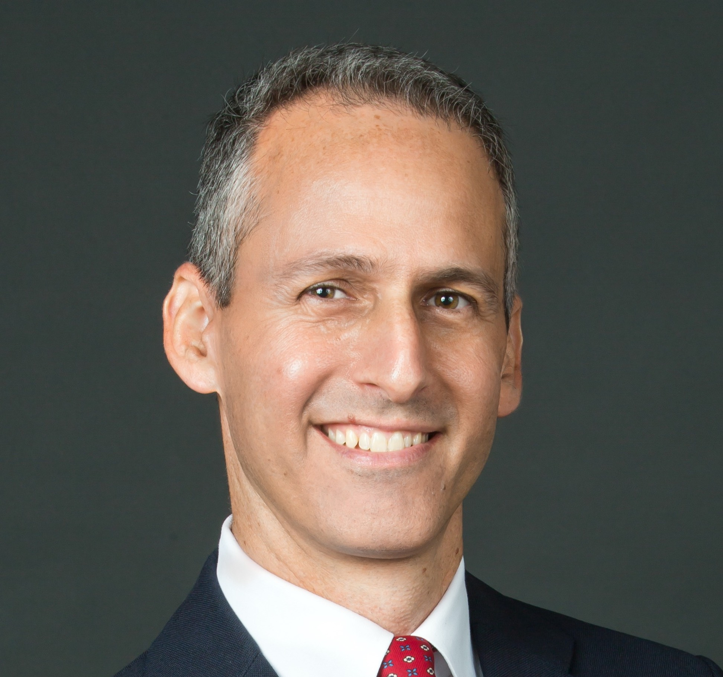

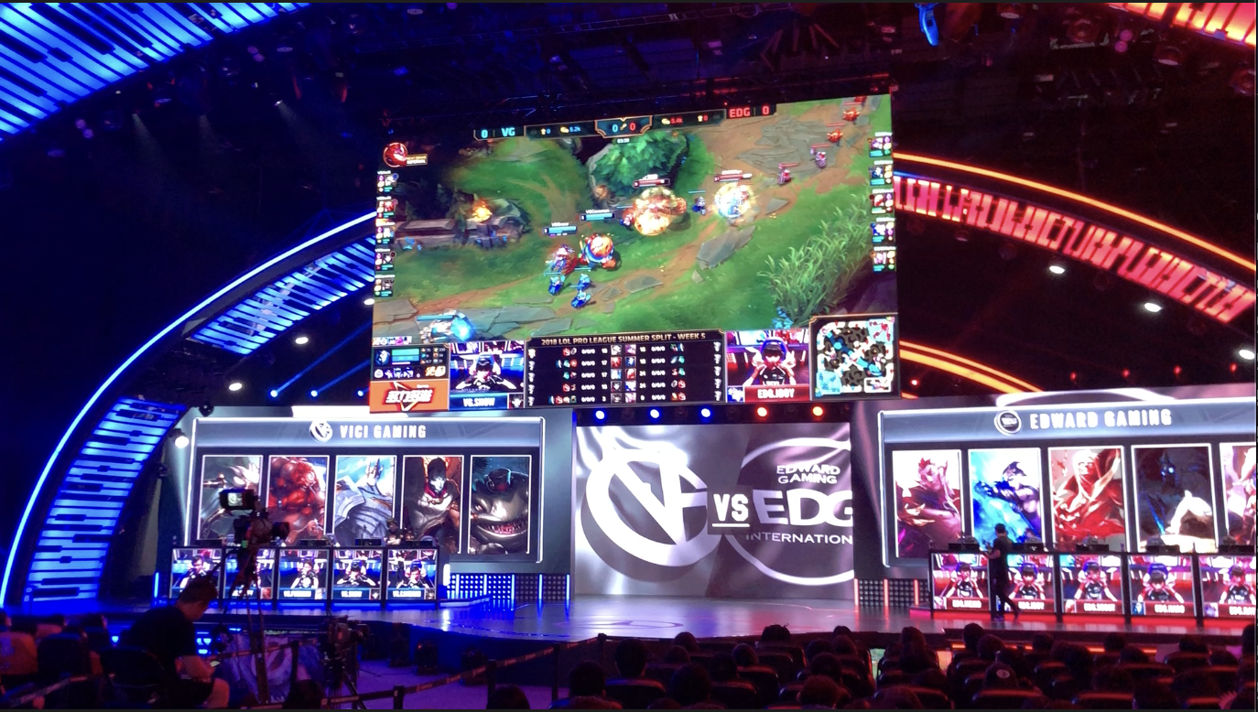
Your Picture
Your Story
Why are you in this Class?
I am a Professor of Operations, Information and Decisions, and the director of the Management and Technology Program.
I grew up in Isarel. Undergrad at the Technion, phd at Columbia.
I have been studying supply chains and global networks for many years, and have been fascinated with the impact china has both on the evolution of global supply chains footprints, as well as on supply chain and retail innovation.
Gad Allon
China Related
Fun Fact About Me
I worked on a project with Tencent redesigning League of Legend. In doing it I watched kids (not mine) watch other kids (not mine) play games

Slide 3
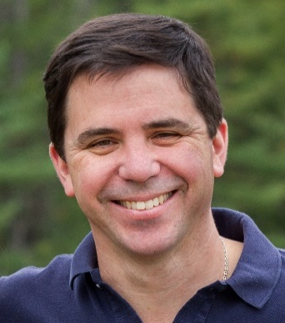
Santiago Gallino
Your Picture
Your Story
Why are you in this program?
I am an Assistant Professor at the OID Department. I am interested in digital transformation and strategy execution issues in the retail industry.
I am originally from Argentina, and before joining Wharton, I lived in New Hampshire.
I find teaching to be a rewarding and fundamental part of my academic life.
A deep understating of Supply Chain challenges is critical to excel in today’s business environment. China has a fundamental role in Global Supply Chains.
I am excited to share my experience in this area and learn from thoughtful and experienced participants.
Favorite Quote
“In theory there is no difference between theory and practice. In practice there is.”
Yogi Berra

Slide 4

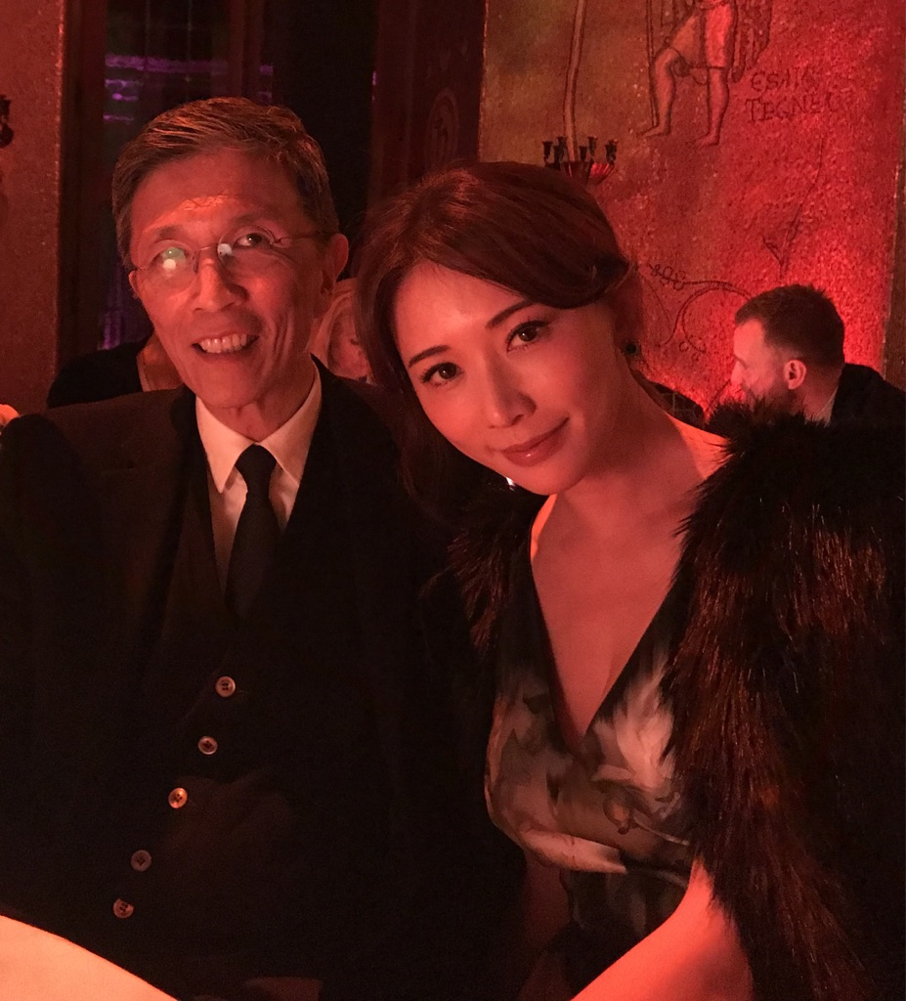


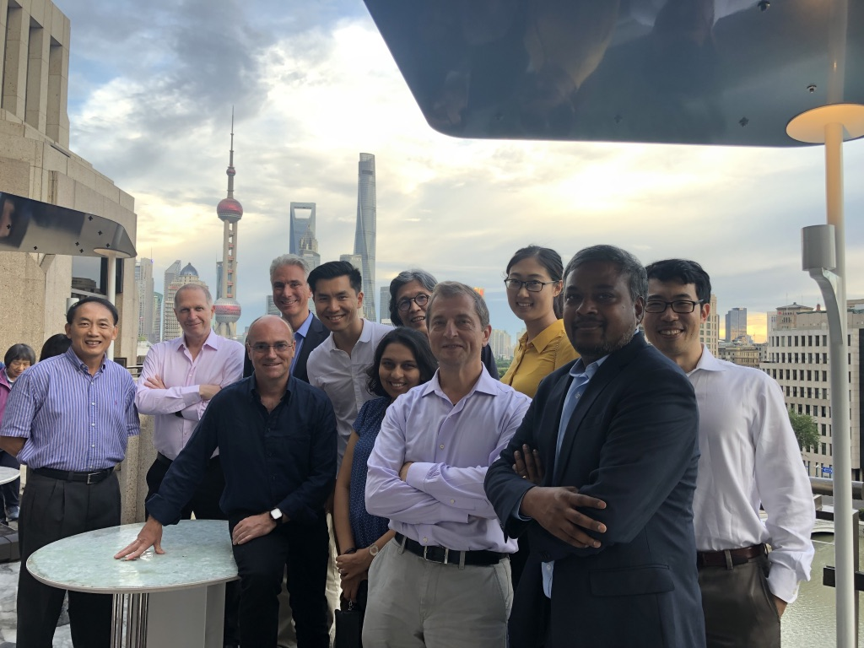
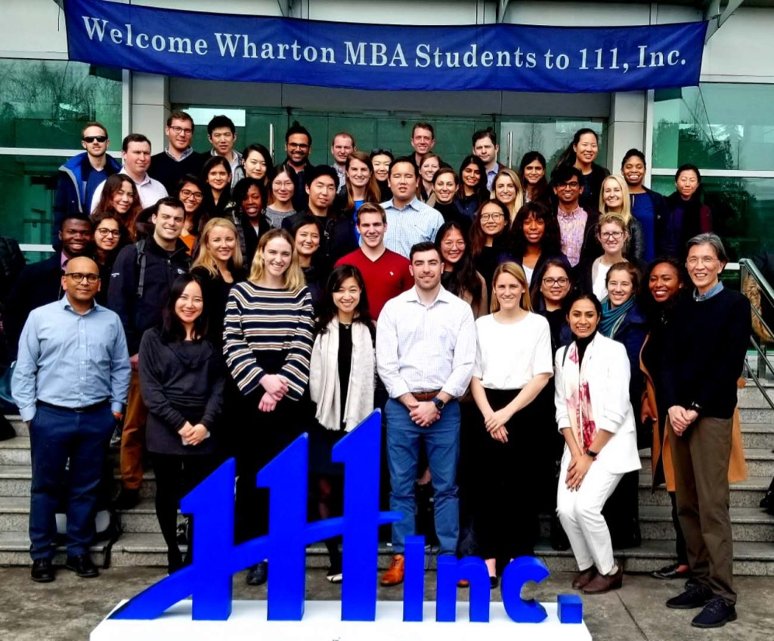
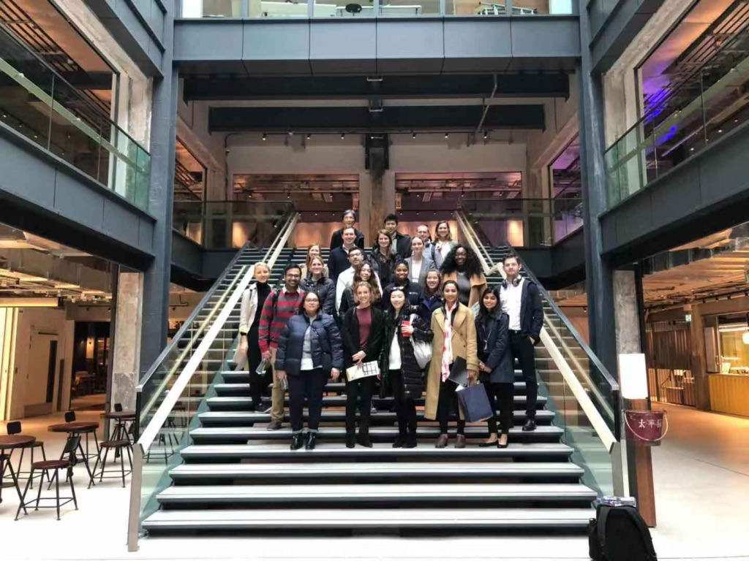
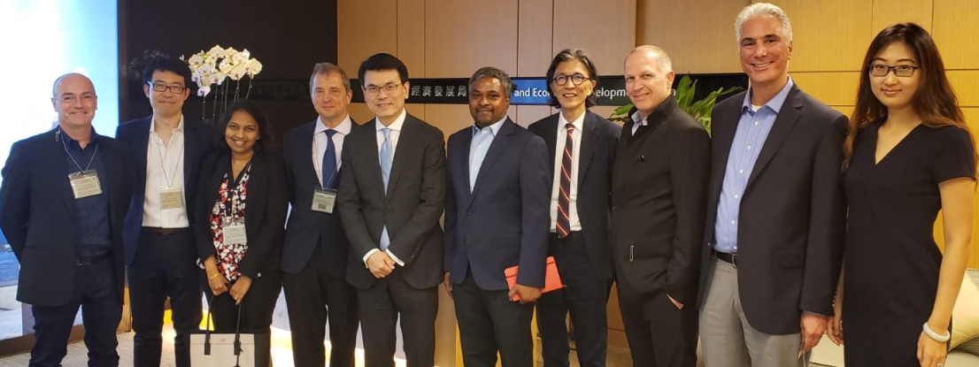

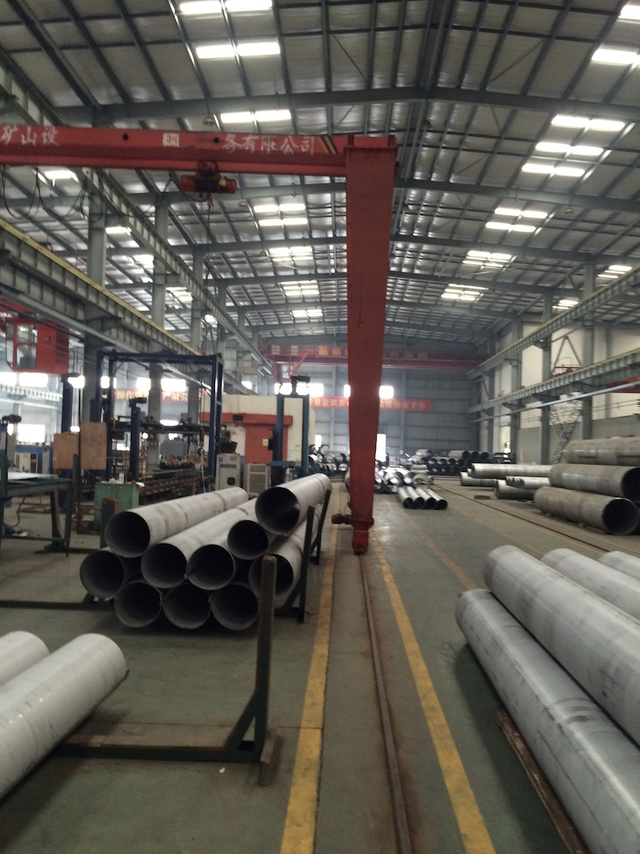
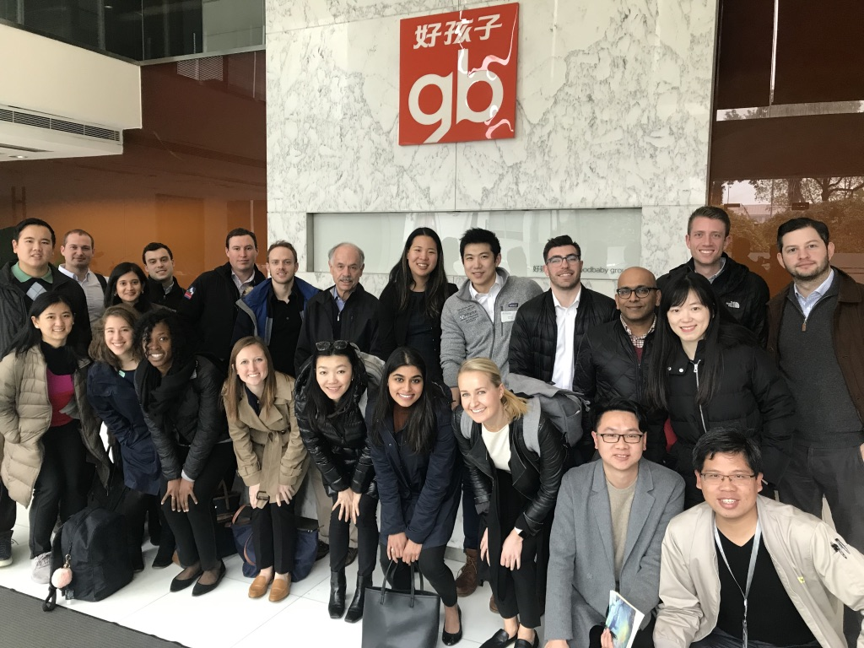
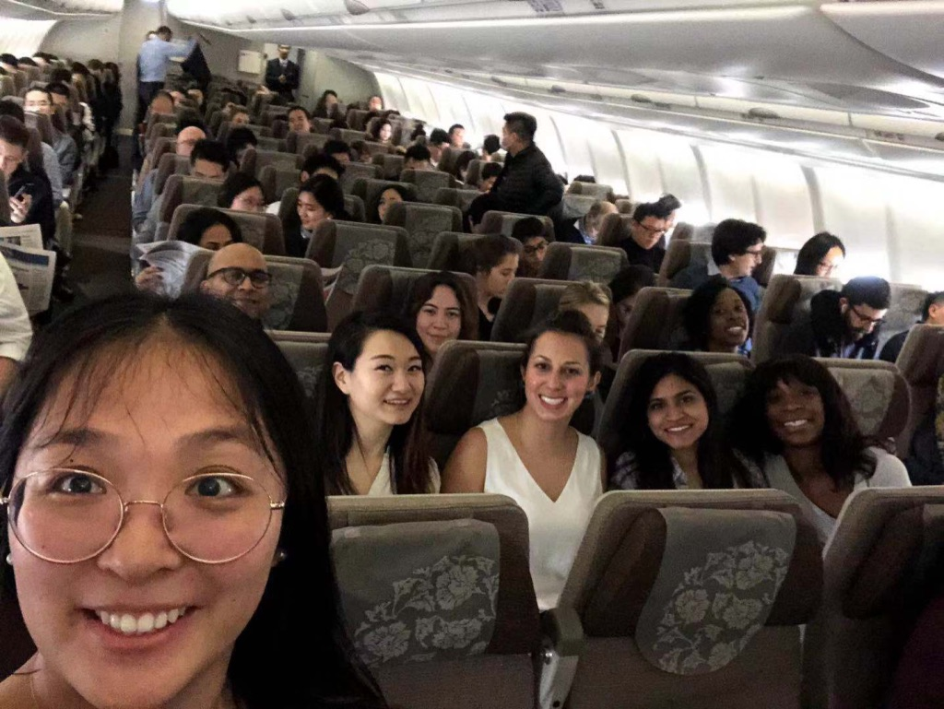
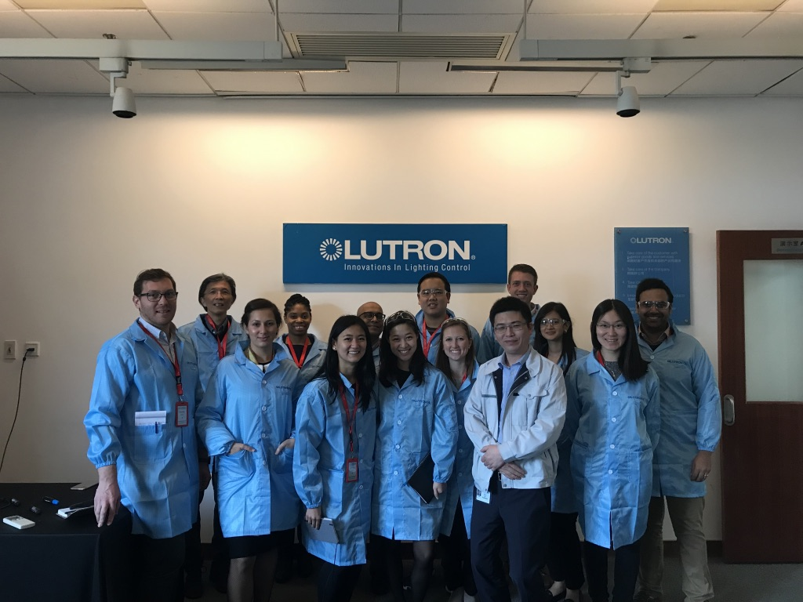
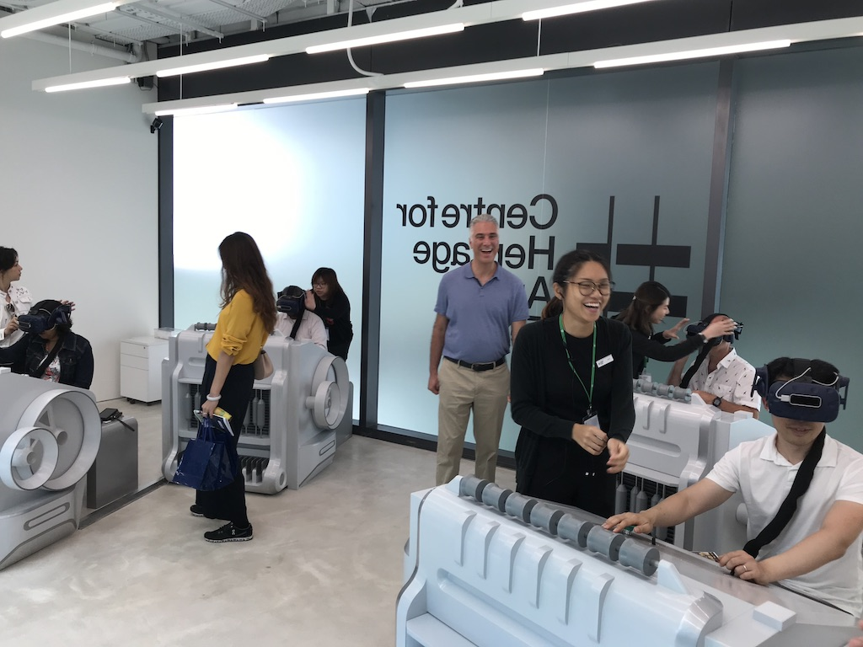
Edwin Keh 葛儀文
Born in Hong Kong, led large multinational consumer product global supply chains for about 30 yrs., teaches supply chain at Wharton, runs a research center (HKRITA).
Find global commerce fast changing, fascinating, and exciting.

